Slide 1
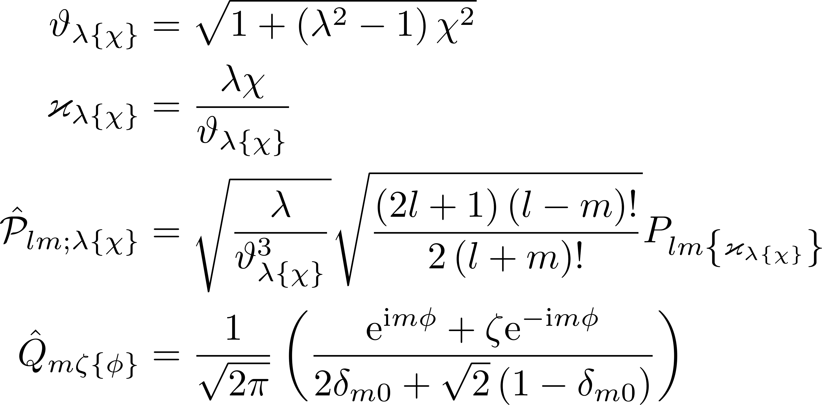
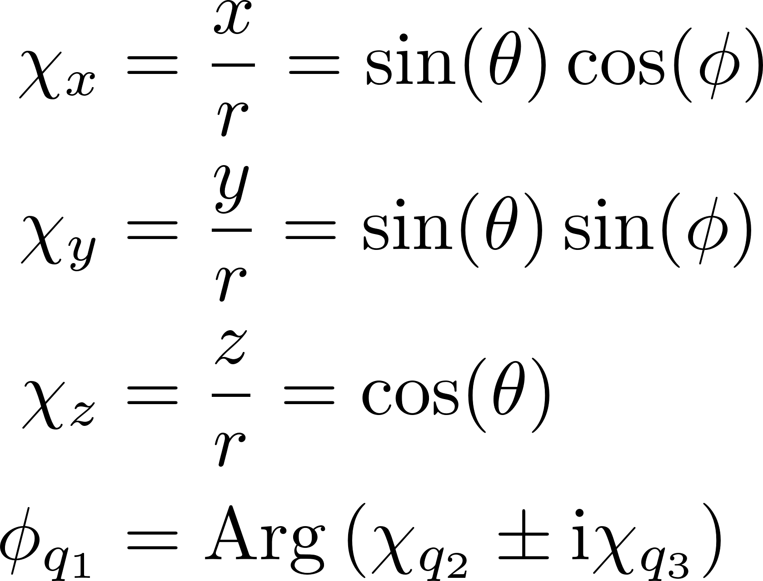
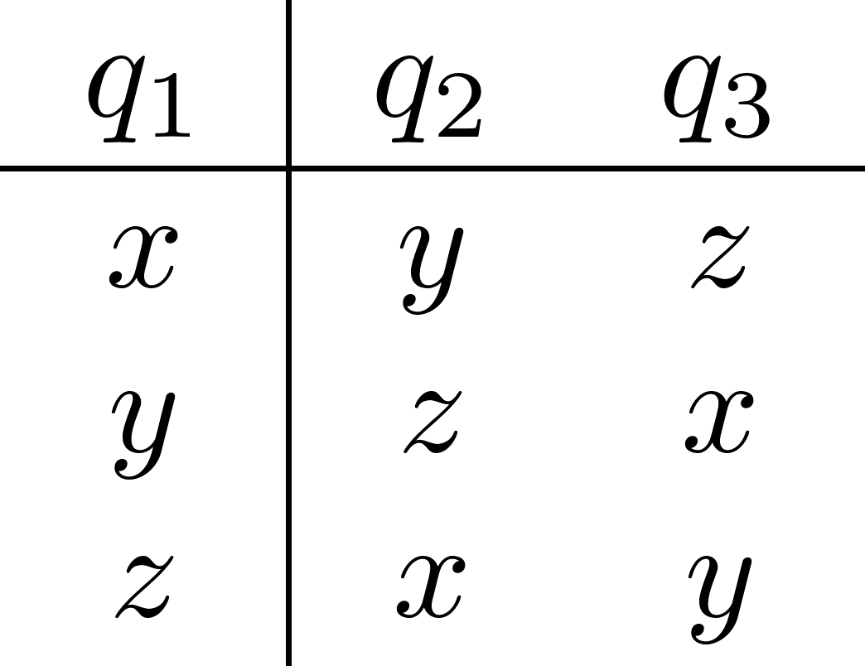
Generalized single-valley basis states (I)

Slide 2
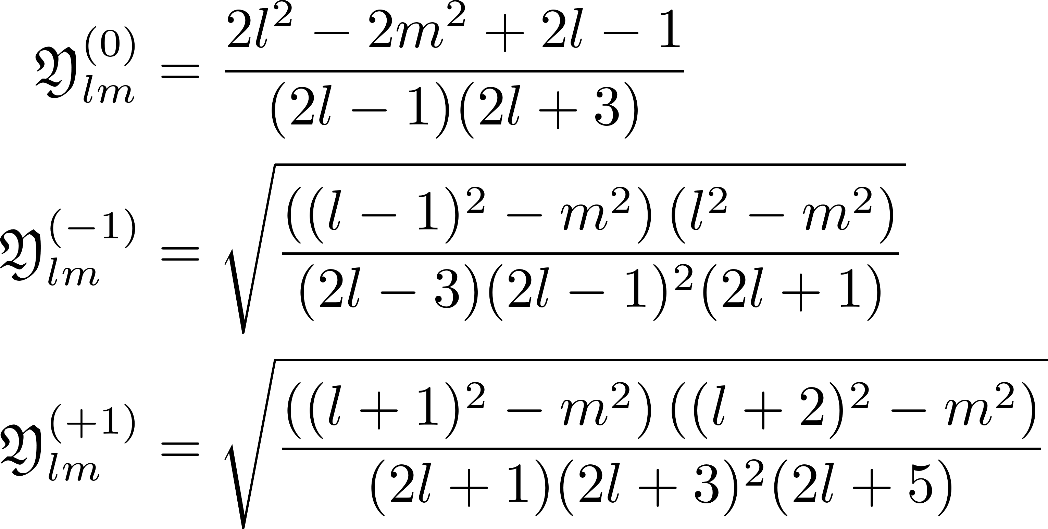


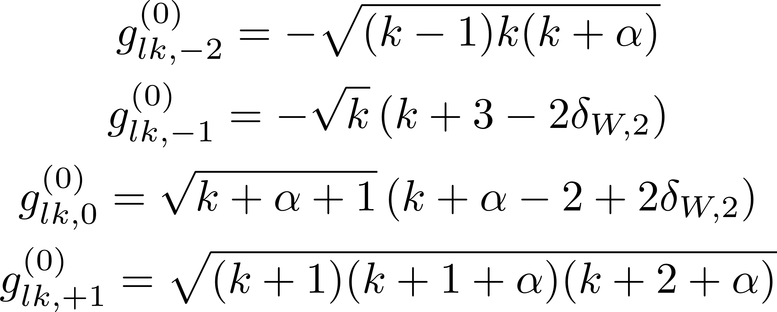
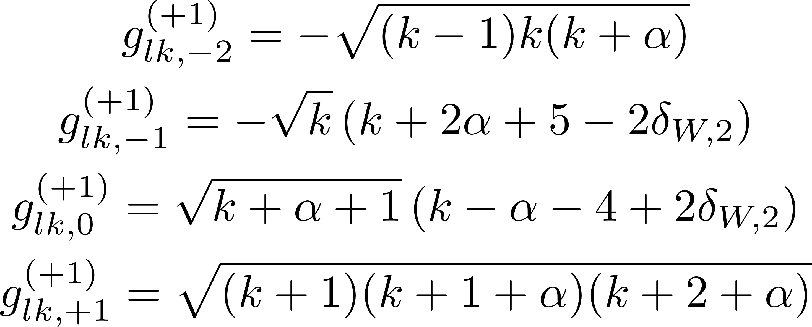


Generalized single-valley basis states (II)

Slide 3
Generalized single-valley basis states (III)

Slide 4



Generalized multi-valley basis states (IVa)

Slide 5

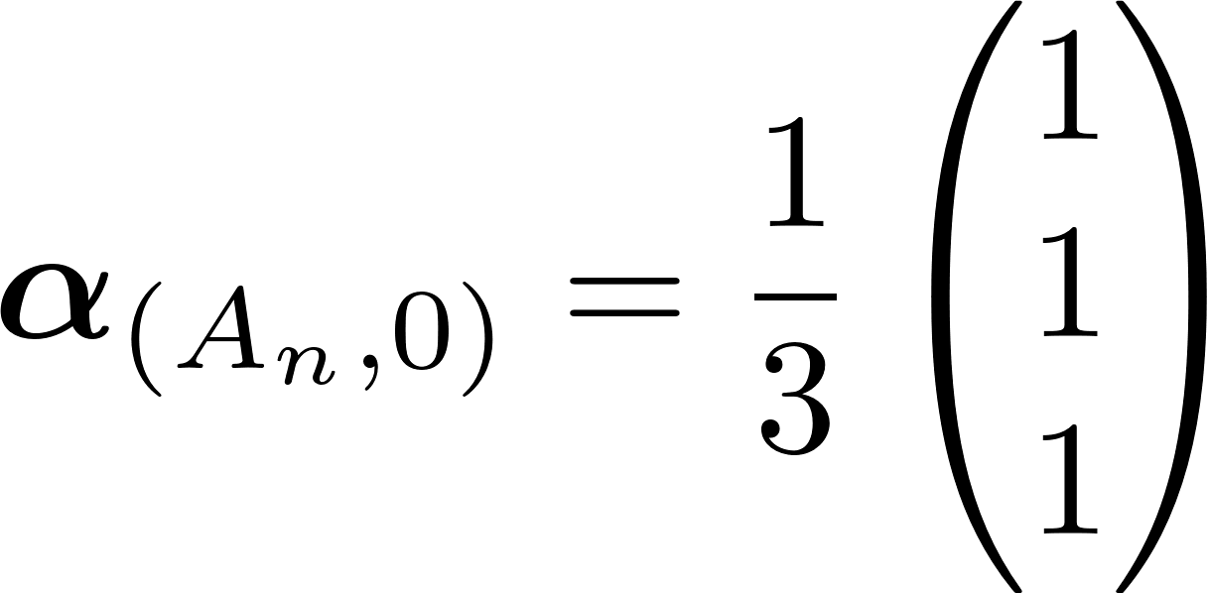
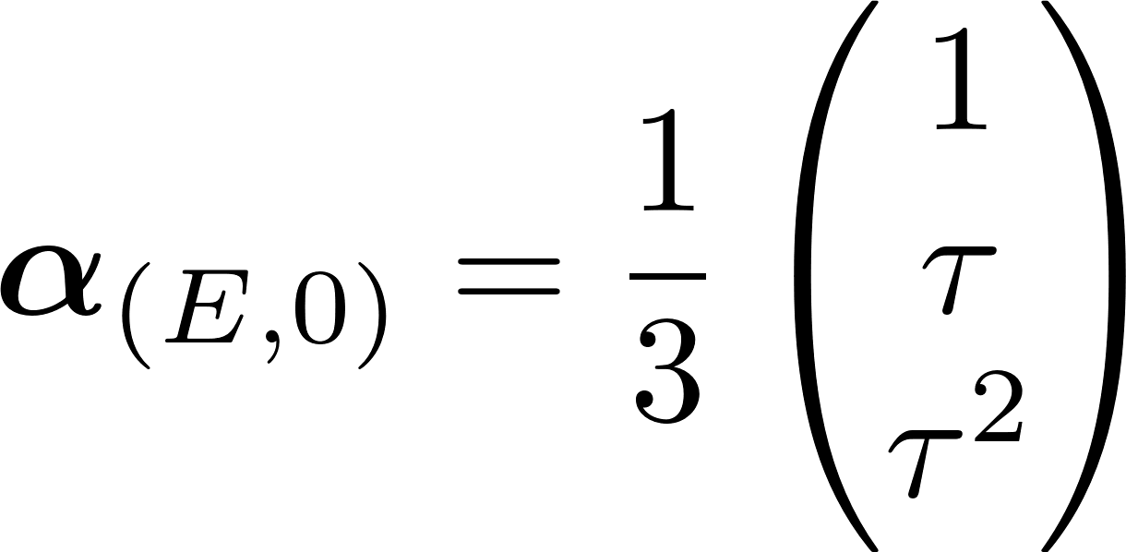
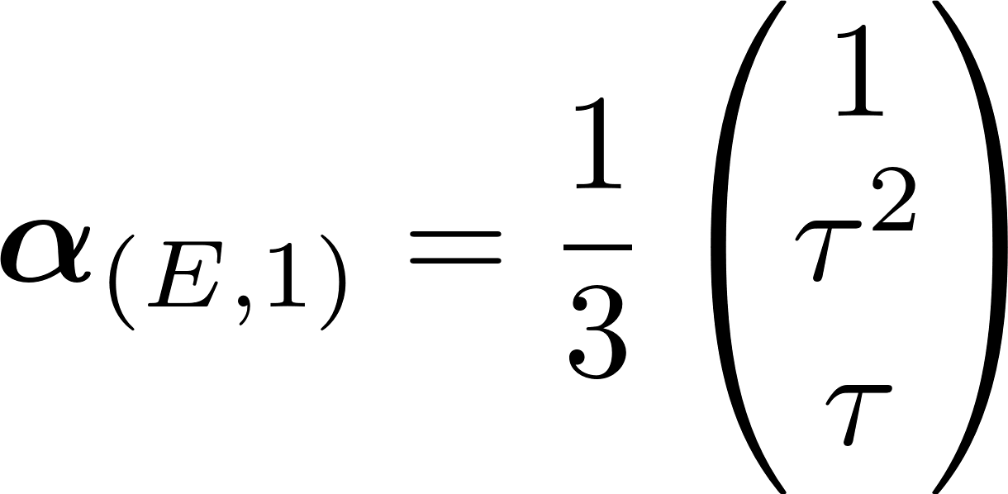

Generalized multi-valley basis states (IVb)

Slide 6
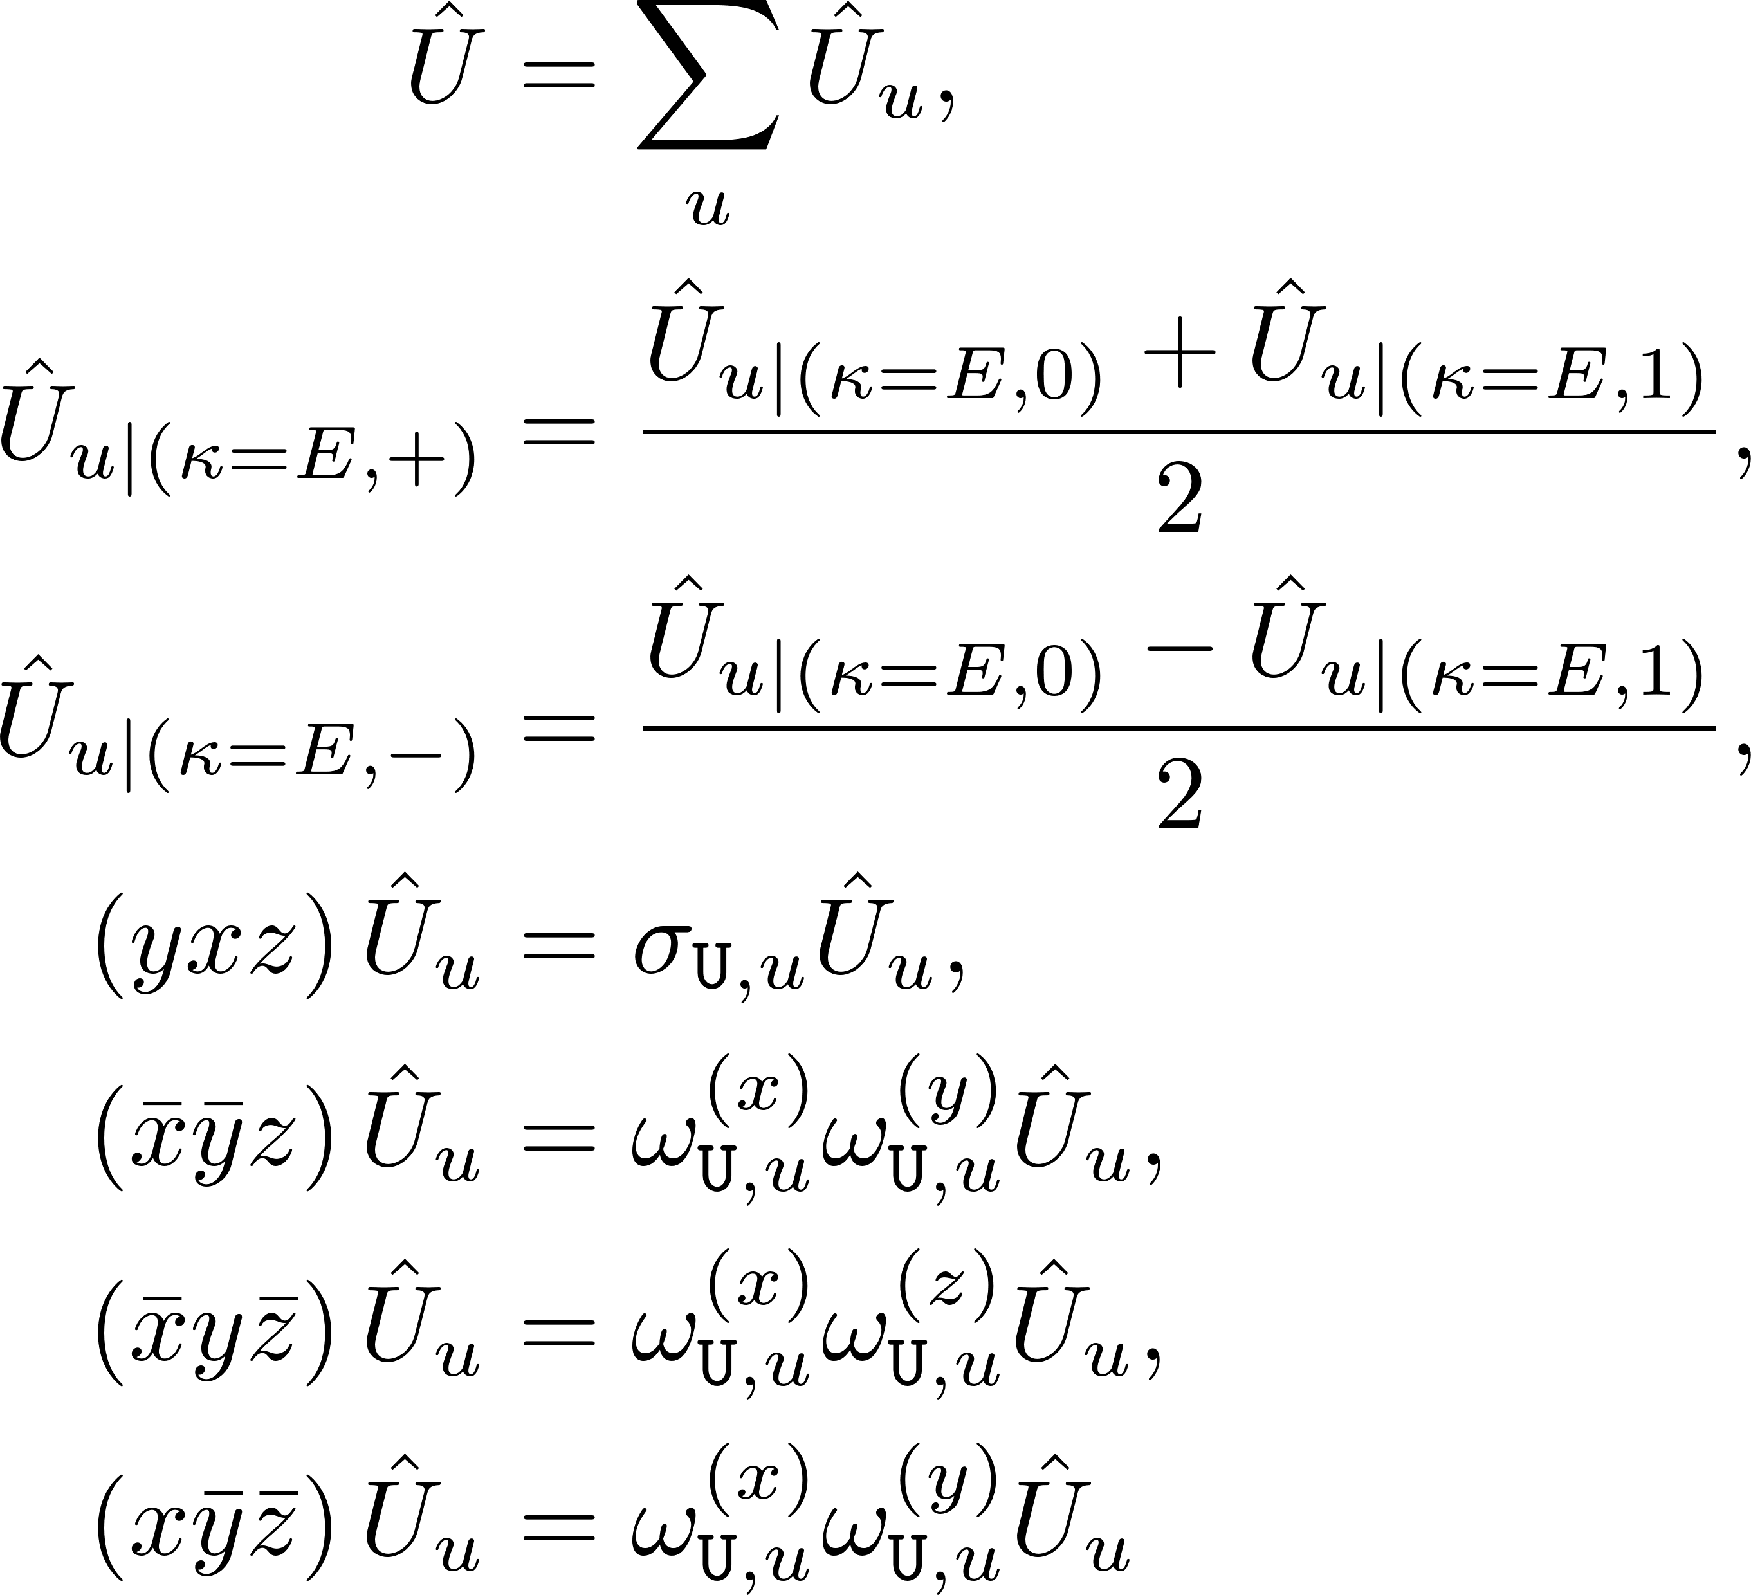
Spatial Potential Forms (I)

Slide 7

Spatial Potential Forms (II)

Slide 8
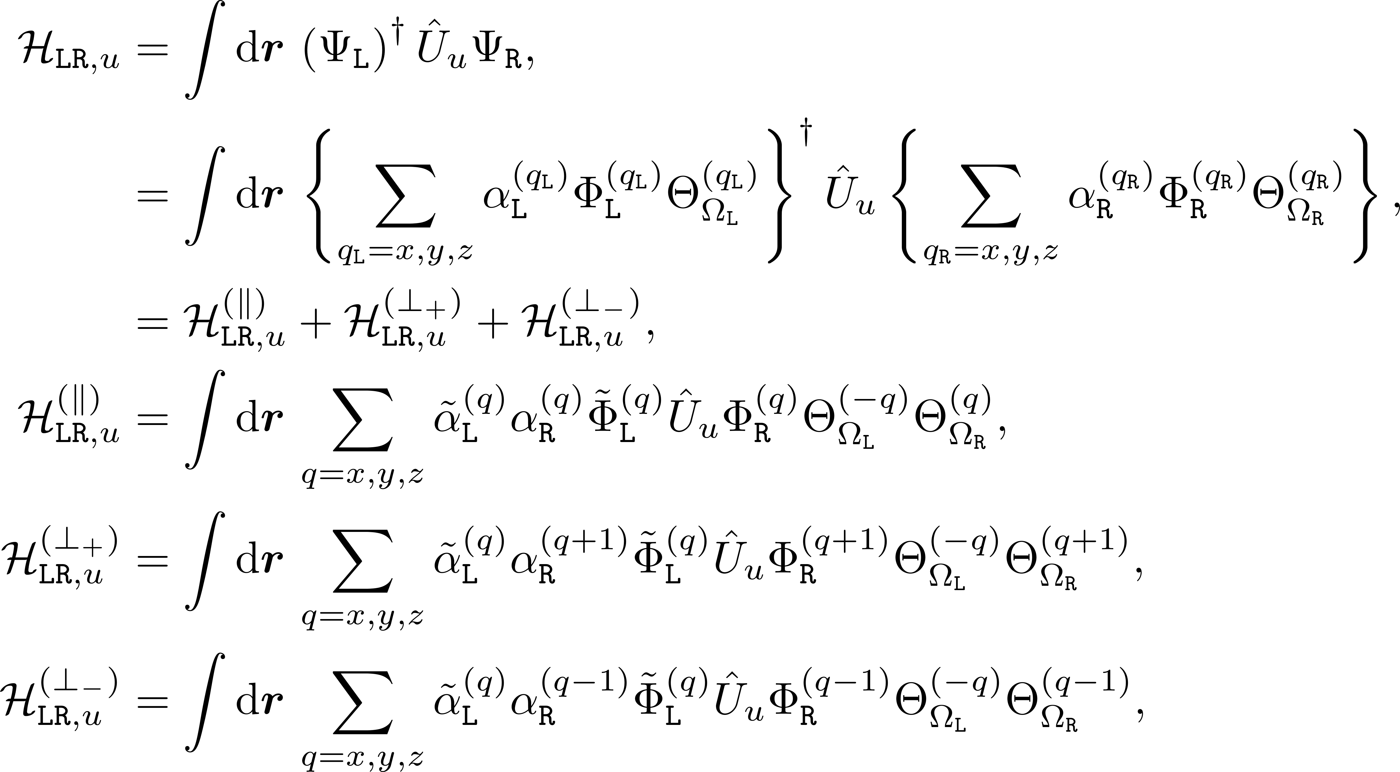
Hamiltonian Operator Integral Elements

Slide 9


Same Valley Hamiltonian Form

Slide 10


Transverse Valley Hamiltonian Forms

Slide 11



Slide 12


Slide 13
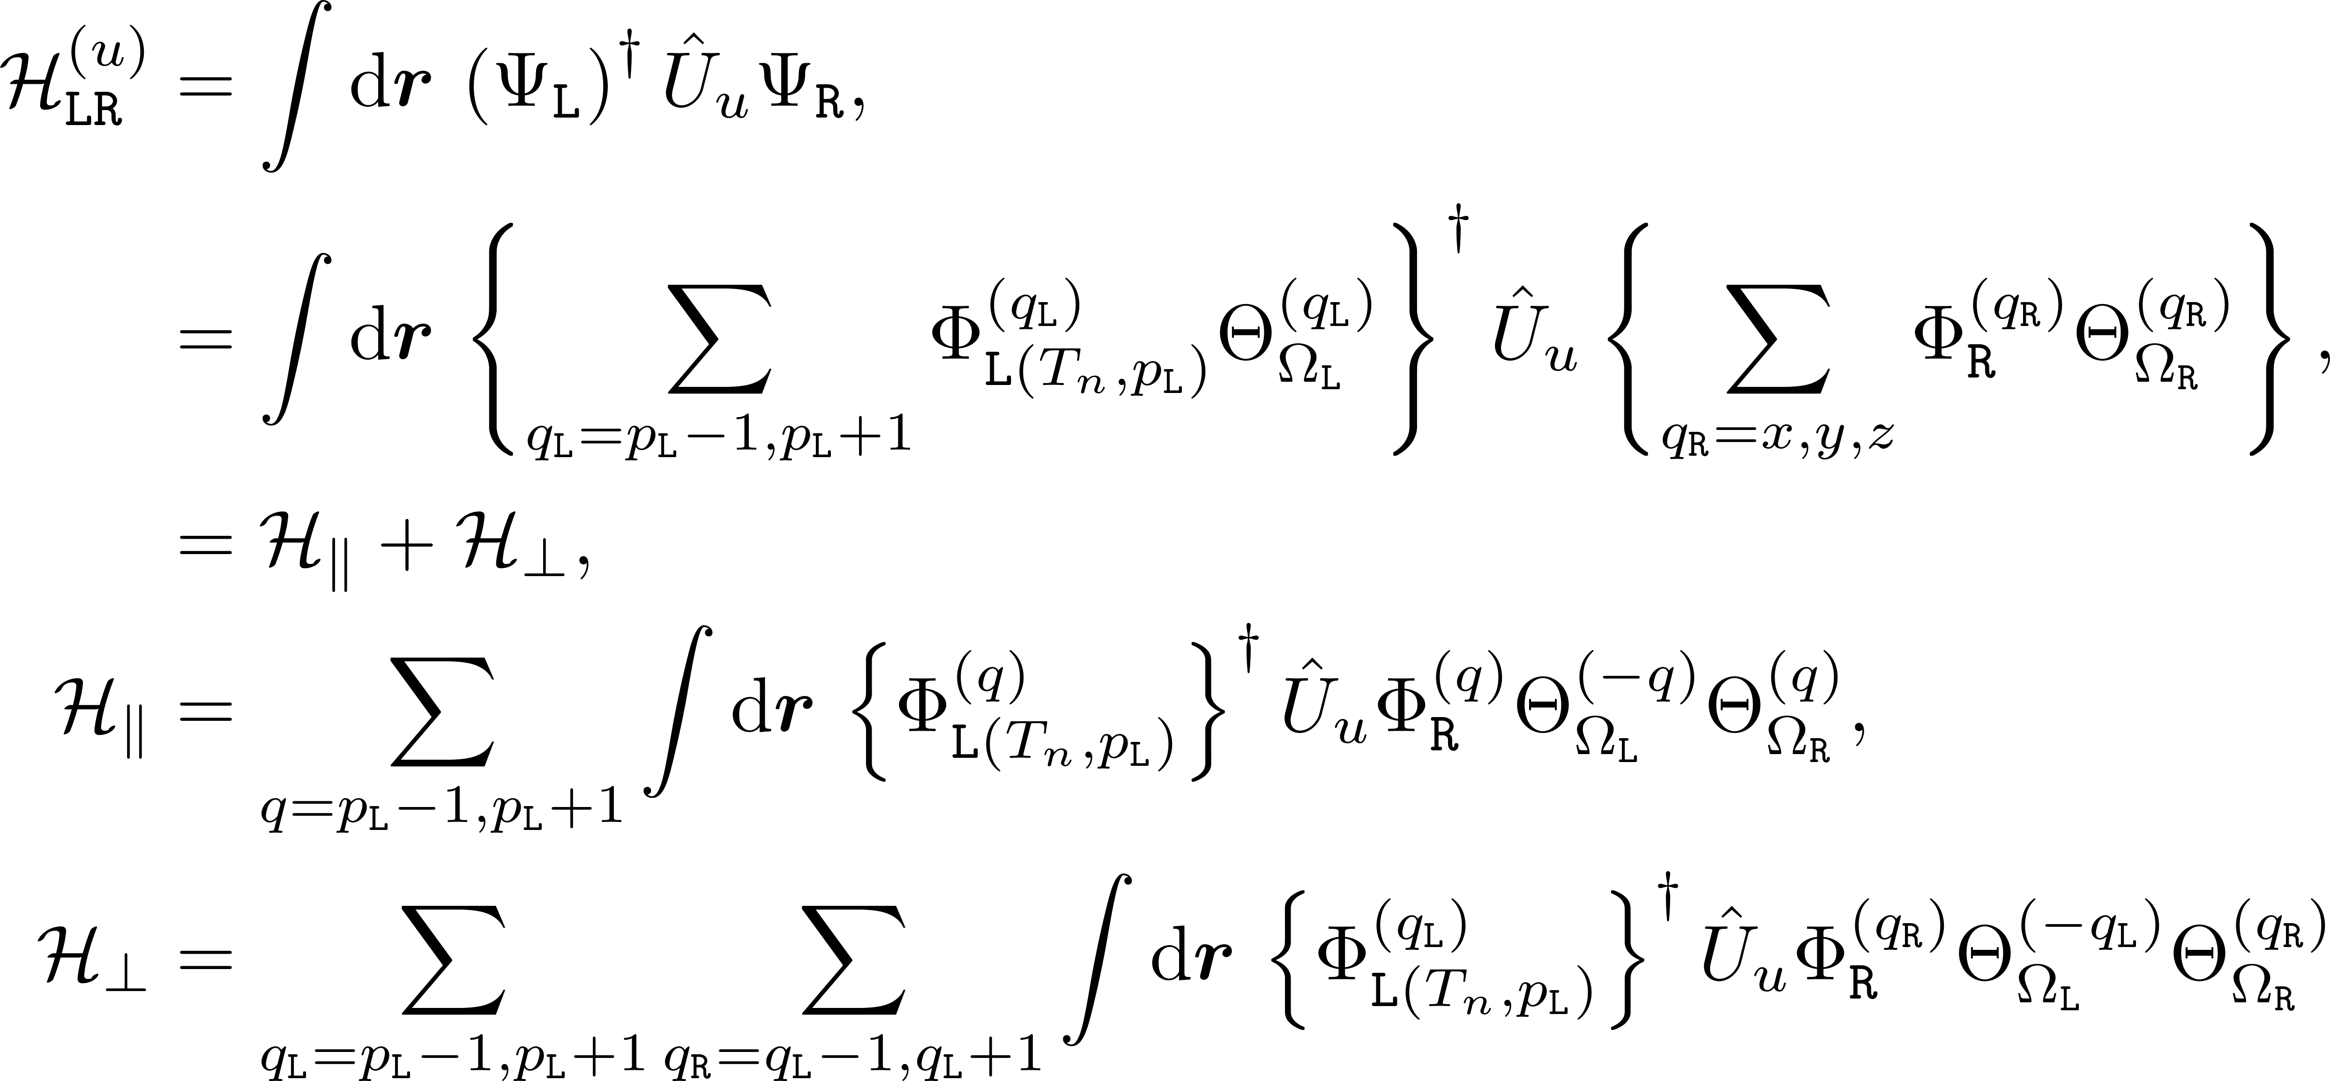

Slide 14
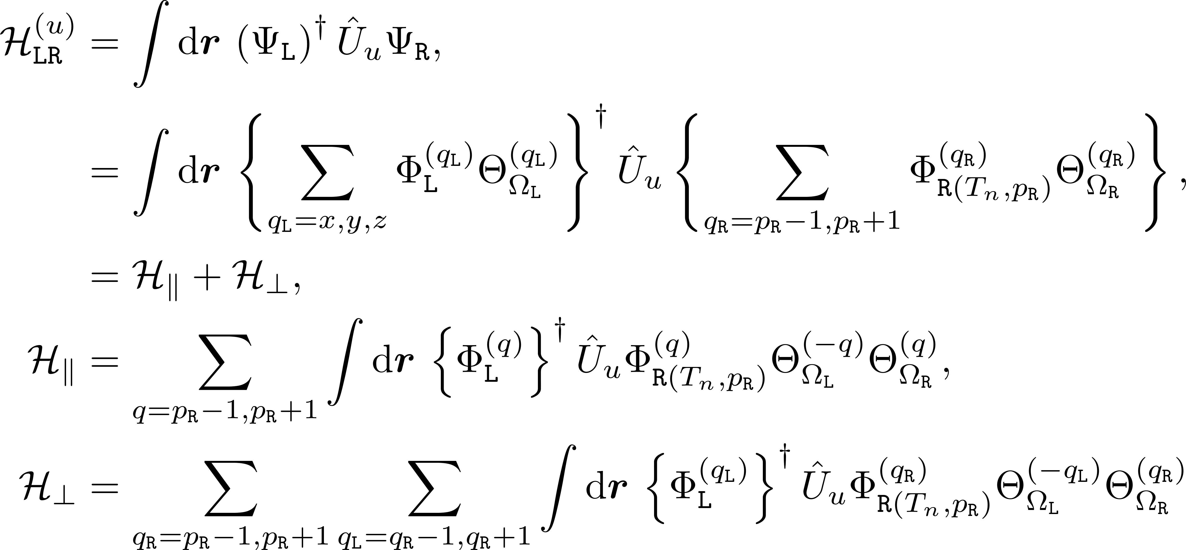

Slide 15
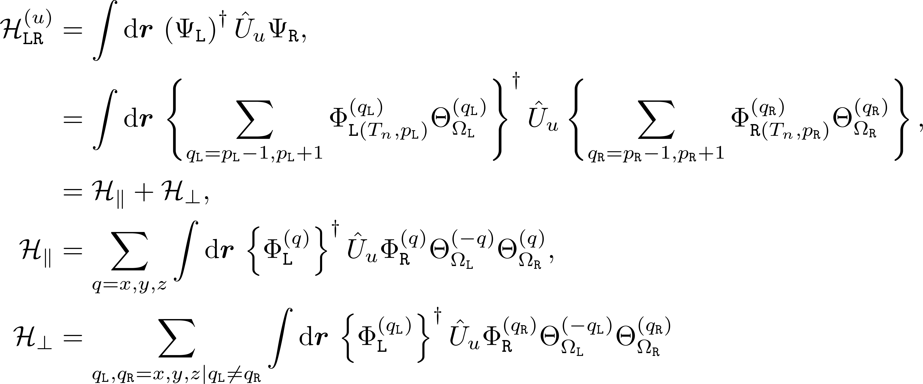

Slide 17

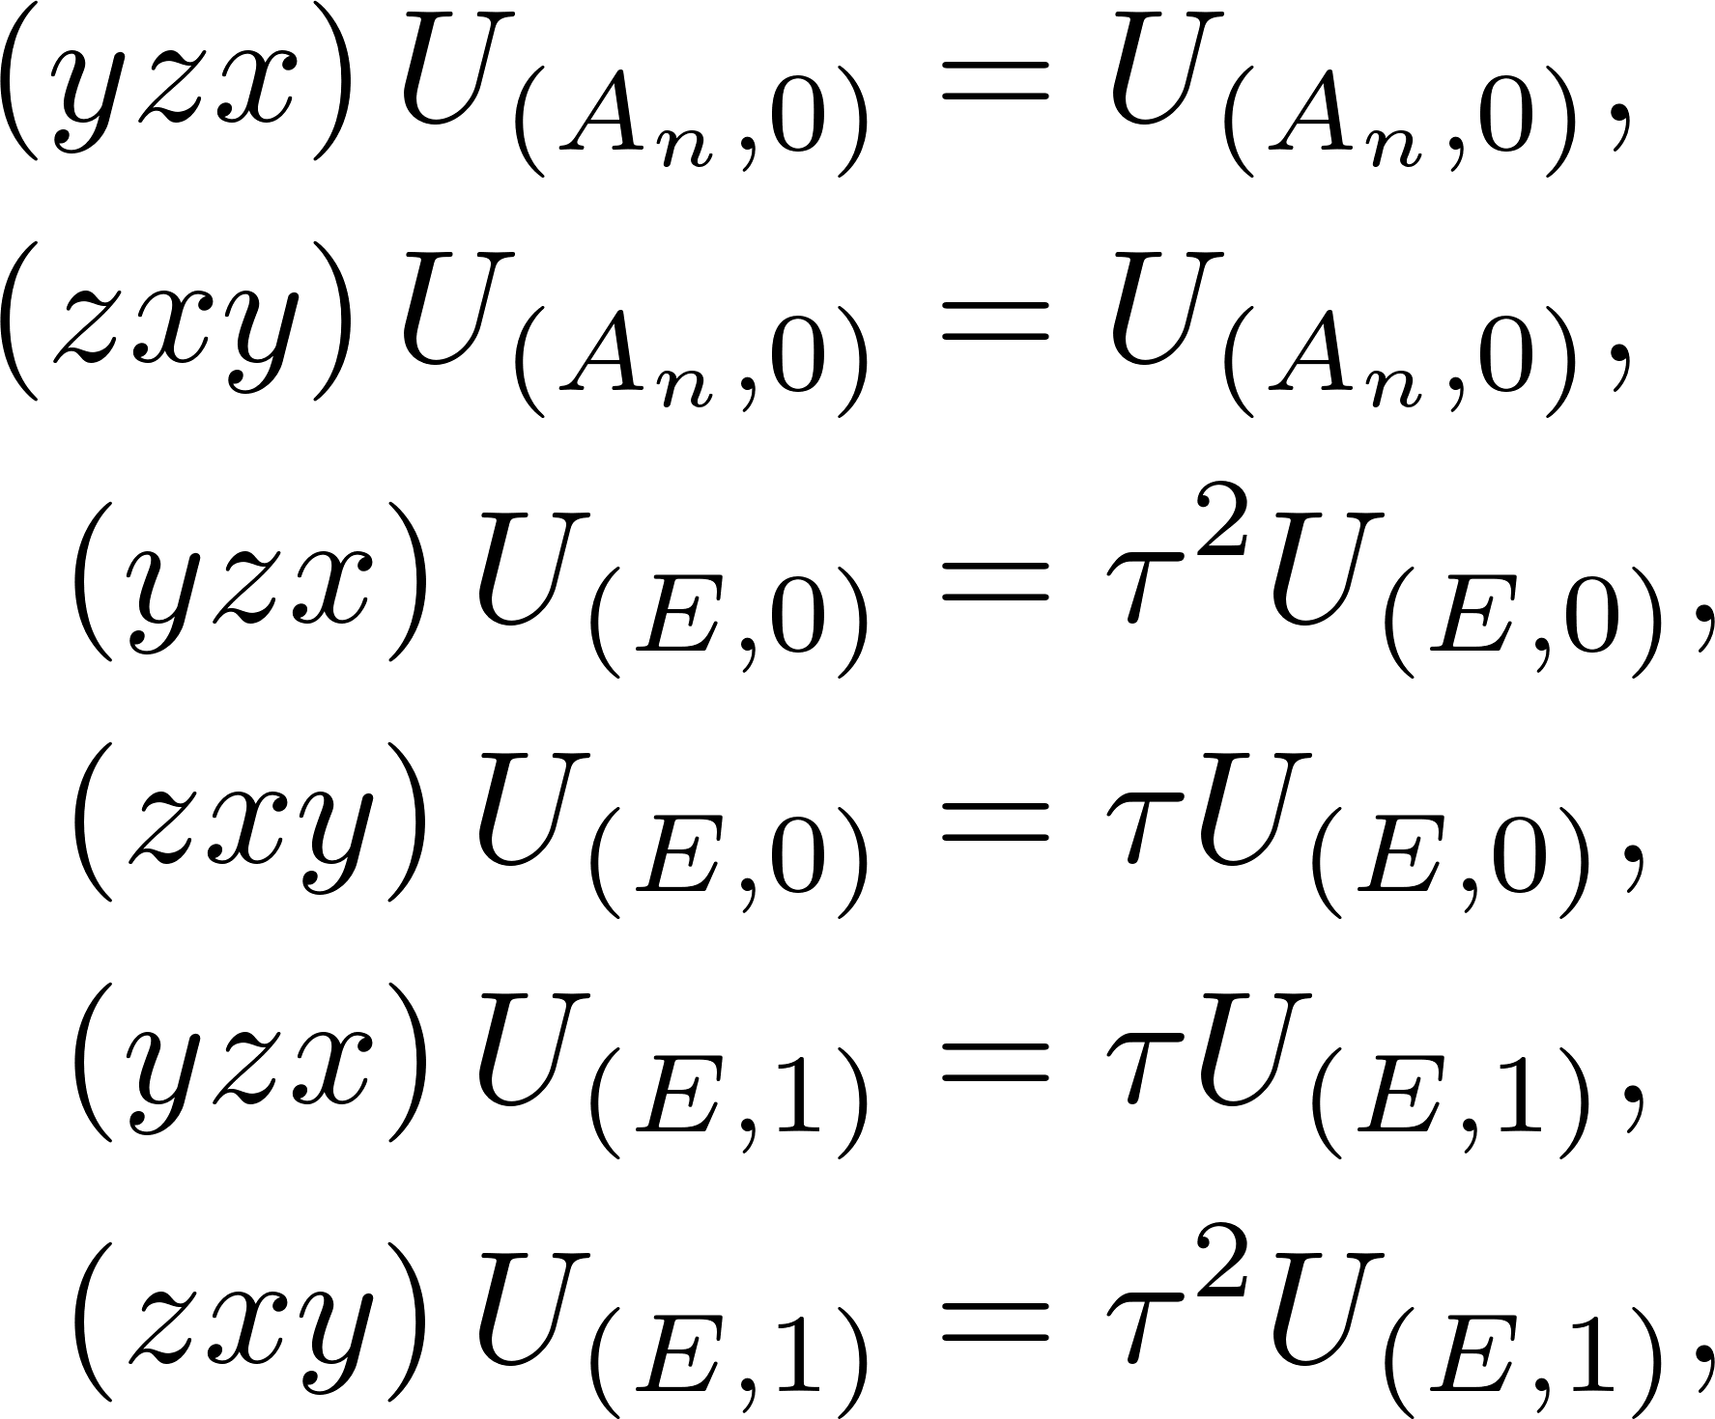
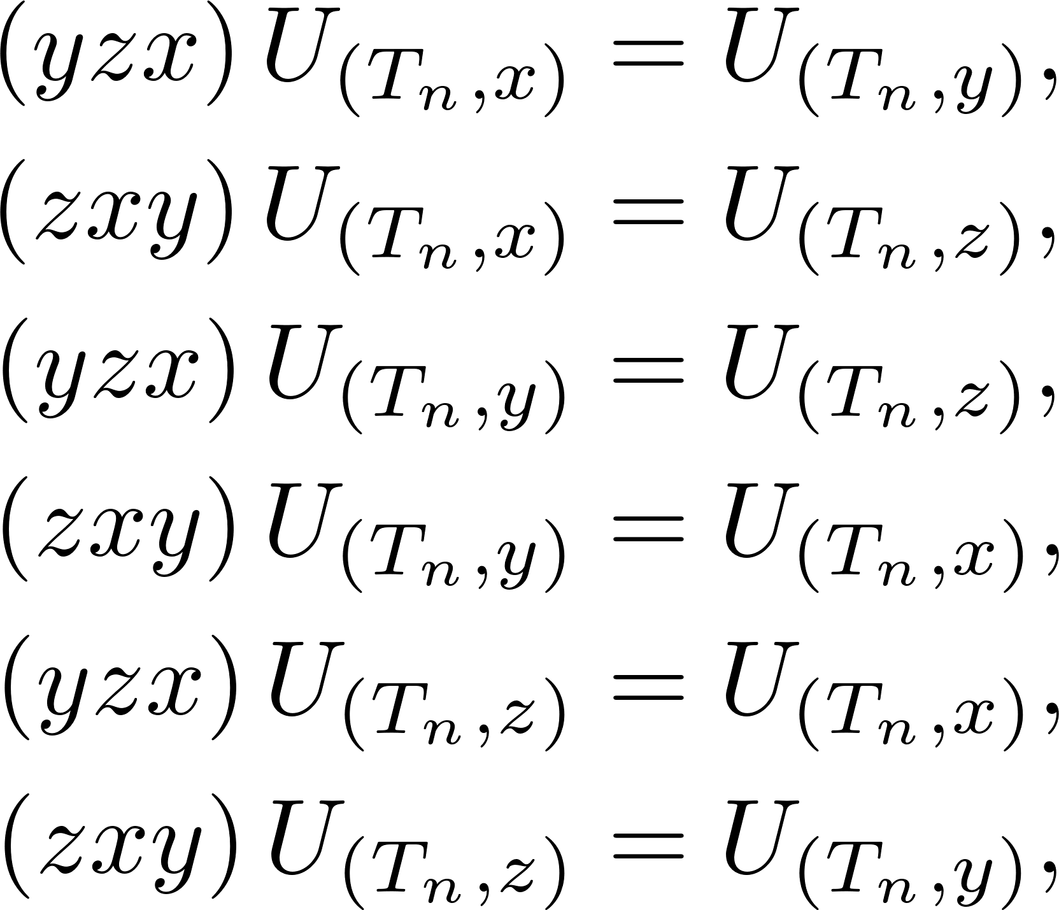

Slide 19
